Slide 1
20uL

Slide 2
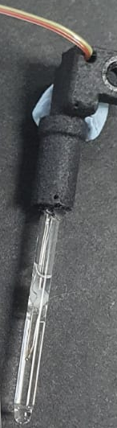
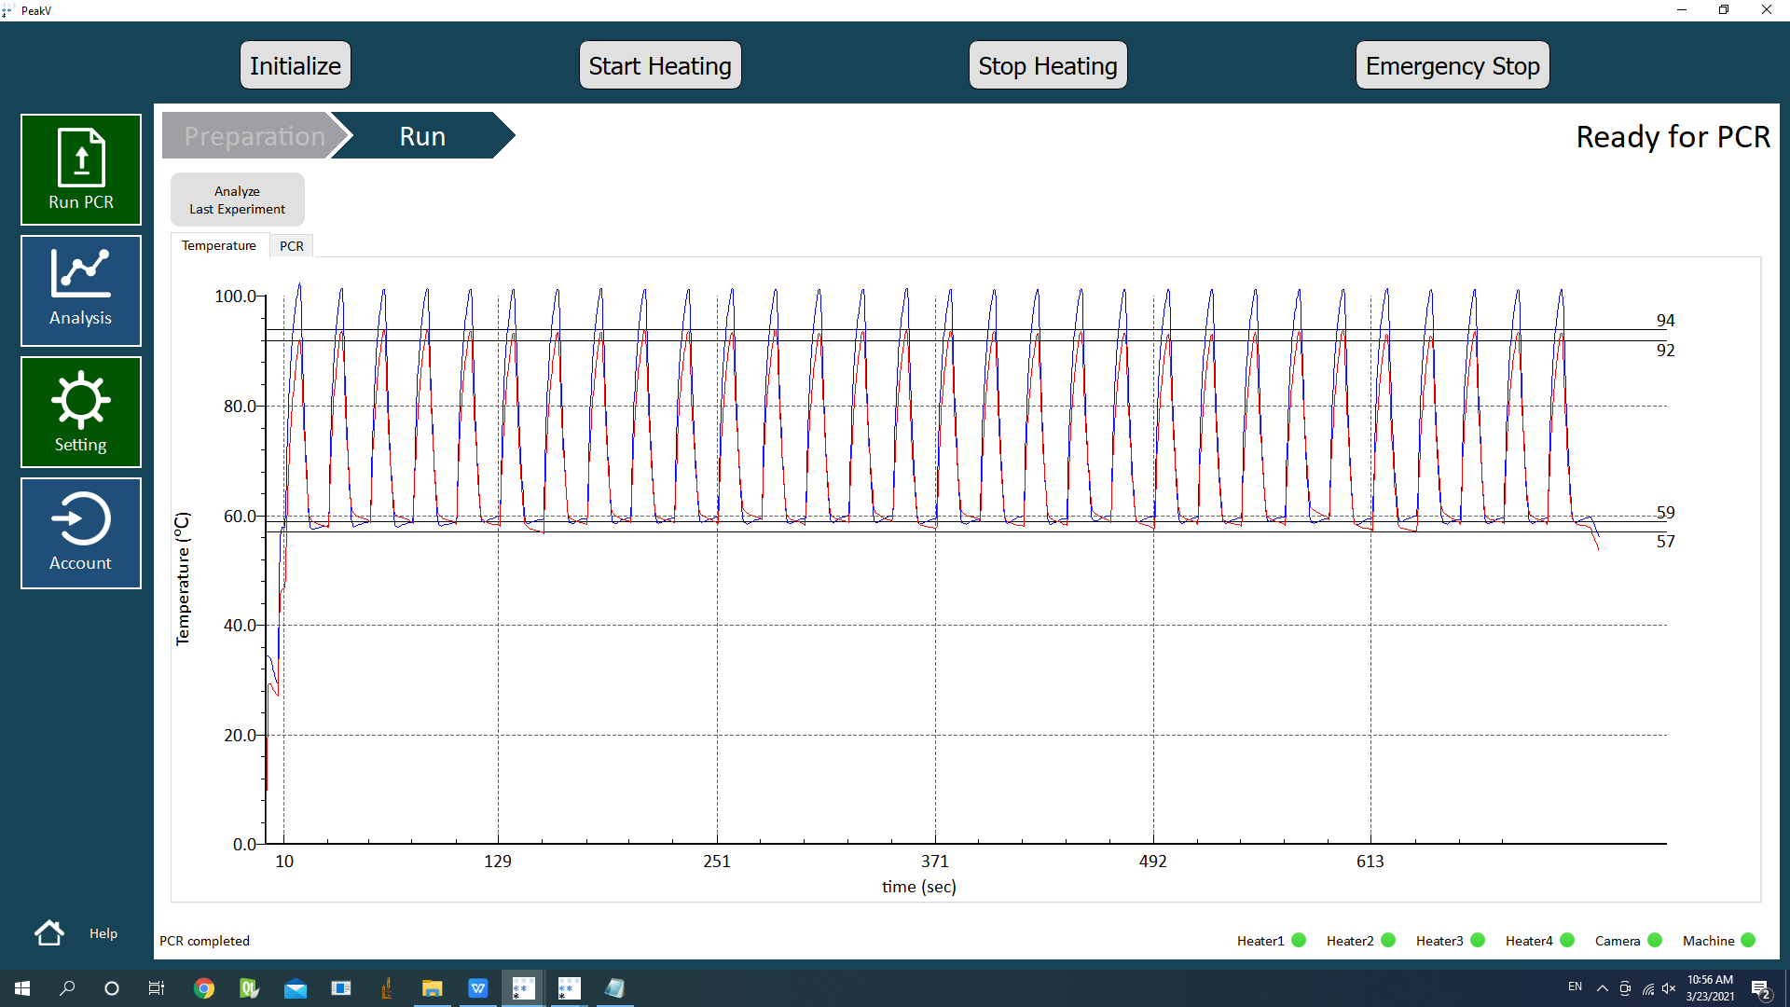
Installed on
SAPV016A0001
2021-03-22_164106
20-1
PA-L01-01
(20uL Benchmark)
Water + Oil + Glue

Slide 3
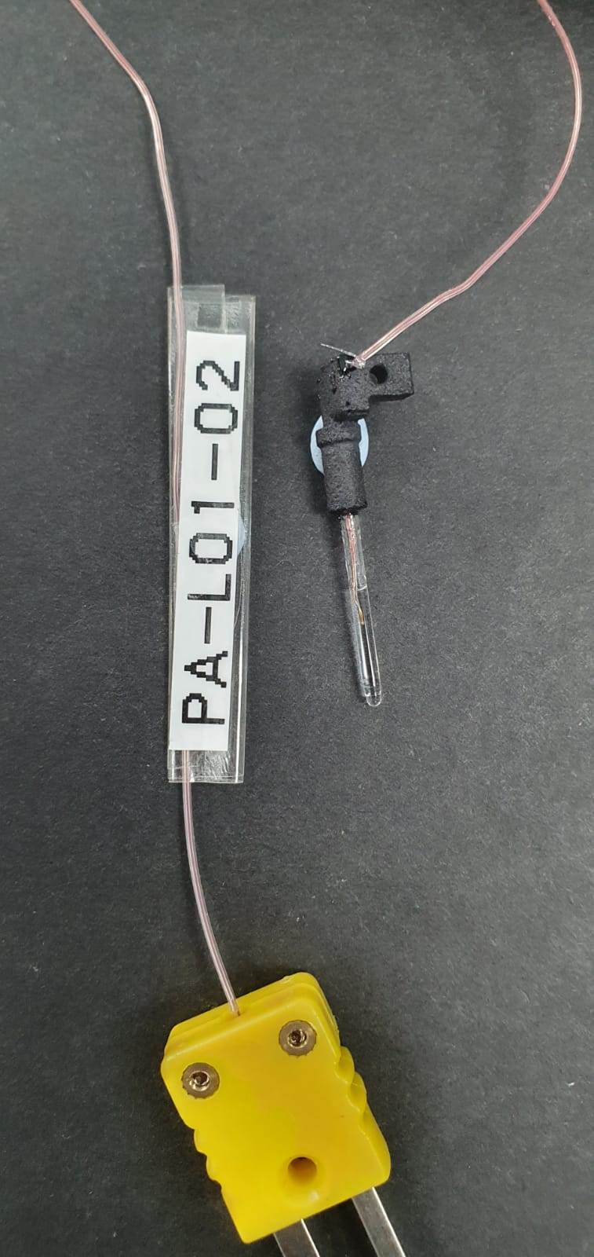
Installed on
SAPV016A0001
2021-03-23_100922
20-2
PA-L01-02
Water + Oil + Glue

